Slide 1
Client Server Architecture
Aviad Cohen

Slide 2
Agenda
Network (Sockets)
HTTP
> Server Architecture
JSON
(HTTP) Client Architecture

Slide 3
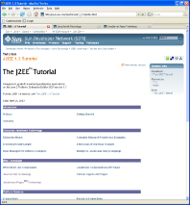
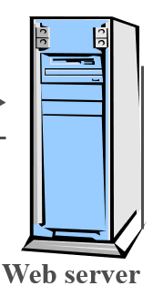

(http) Server Architecture
A piece of code that aims to handle certain logic
Receives HTTP request
Generates an HTTP response
Client(s)
request
request
Resource logic
response
response
Web bowser
Web server
Mobile App

Slide 4
What should we do to write a server ?
Writing a server includes:
Setup sockets infrastructure
Implement HTTP parser (for request and response)
Manage threads behavior
Automatic error handling
Manage sessions and external storage
Write the server logic

Slide 5
Server Shell
Server shell handles most of the technical code (handling sockets, threads management etc)
Free’s developer to handle:
Logic: ‘per\for resource’
Routing: mapping url resources to the logic
Server shell is usually a 3rd party product that you can use (rather) easily:
Tomcat\Jetty in java
Express in NodeJS
Flask/Django in Python
ASP.NET in .NET
Gin\Fiber in GO
Crow\Pistache in C++
etc…

Slide 6
Server Shell – Endpoint(s)
Endpoint is a definition of how a certain resource is exposed
End point definition will usually include:
Name of the resource | /users/menash
HTTP verb to use | GET
User input (if needed) | query parameter \ request body
Implementation:
  Logic per resource
  Build (http) response

Slide 7
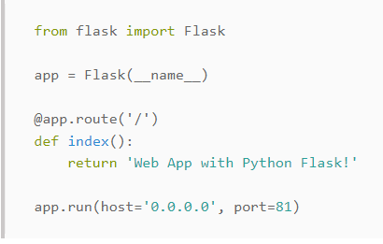
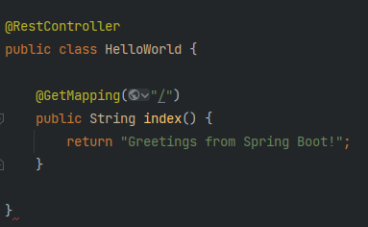
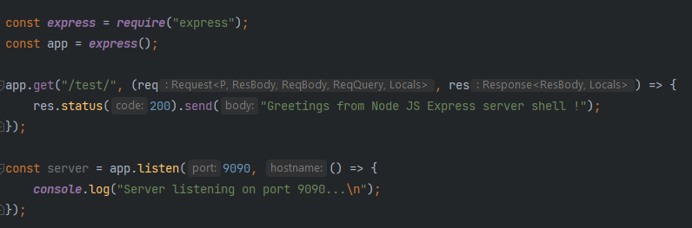
Server Shell - examples

Slide 8
Server shell
Java |Node JS
DEMO

Slide 9
Agenda
Network (Sockets)
HTTP
Server Architecture
> JSON
(HTTP) Client Architecture

Slide 10
WEB data formats
Historically, web started with delivering, mainly, HTML data.
Data was mostly arranged in XML format (on server side)
Java Script (not to be confused with Java what’so’ever !) as dominant, crucial ingredient of Web development
JS offers new data format:
JSON: Java Script Object Notation

Slide 11
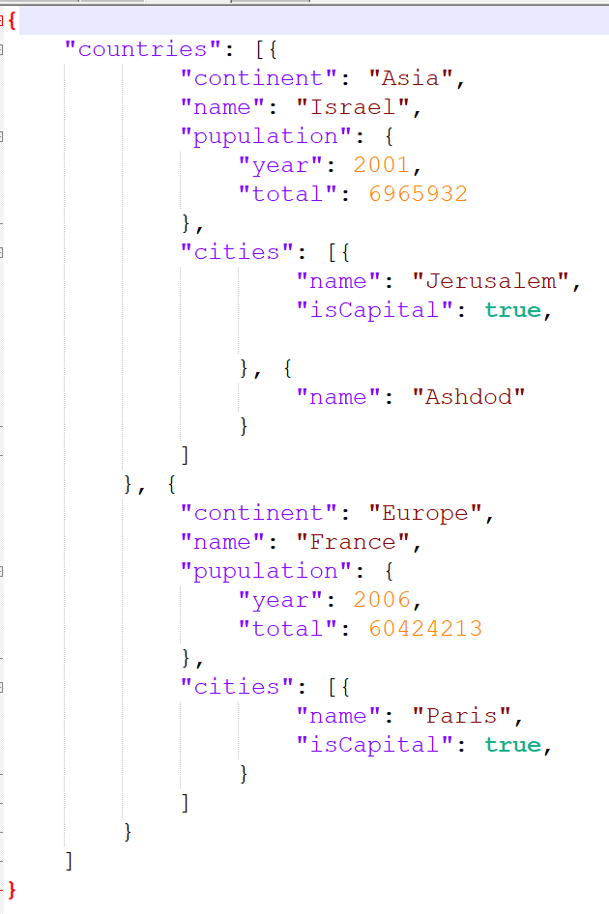
world.json format

Slide 12
JSON – common (basic) types
JSON regular values:
Number: either integer or fraction
String: either enclosed with “ “ or ‘ ‘
Boolean: true | false
Json Array
Enclosed in square brackets [ ]
Can hold any JSON type, even mixed
Values are separated by comma ‘,’
Indexed by 0 based
Access with indexer []
4 934.523
“hello” ‘menash’
true false
[] – empty array
[4, “menash”, [], true ]
arr = [1, 2, “mosh”]
arr[2] → “mosh”

Slide 13
JSON – a JS object
    {
    key : value,
    key: value,
    …
    }
  JSON is merely a key-value pairs:
  Basic Object structure:
Object is enclosed within curly braces { }
Key-Value pair structure is divided by semicolon ‘:’
  Key can be a string or a number
  Value can be anything: string | number | array | boolean | object
Multiple pairs are separated by comma ‘,’
There is no formal structure of the object (at least not as you are used to in C++\Java\.Net etc.)

Slide 14
JSON and Object Oriented
  There is a valid transformation capability between OO and JSON
This is a (very long) String
Class Student {
private String name;
private int age;
private List<Integer> grades;
private Teacher favoriteTeacher;
}
“
{
“name”: “menash”,
“age”: 39,
“grades”: [29,49,38],
“favoriteTeacher”: {
“name”: “avrum”,
“age”: 96,
“subjects”: [“tushba”, “tongue”, “math”]
}
}
To Json
Class Teacher {
private String name;
private int age;
private List<String> subjects
}
From Json
“
Teacher t = new Teacher(“avrum”, 96, …)
Student s = new Student(“menash”, 39, ...)
s.setTeacher(t);

Slide 15
JSON Parsing
  Different technologies hold multiple implementations for such capability:
NodeJS: native implementation
Java: Jackson, Gson
Python : built-in package: json
.NET: built-in package \ newtonsoft (json.NET)
etc..
  Using these capabilities one can (easily):
Convert any Object and\or data structure to a json (string) structure.
This will be super useful as the server can now return raw data stored in objects as a JSON string.
Convert any JSON structure (given as a string) to native technology objects
Typically on the client side, the JSON string will be converted to the technology-specific Object structure

Slide 16
GSON
JSON based endpoint
DEMO

Slide 17
Agenda
Network (Sockets)
HTTP
Server Architecture
JSON
(HTTP) Client Architecture

Slide 18










HTTP Clients
Http Clients are entities that invoke HTTP requests, and expect to get HTTP responses in return
Most commonly known:
Browser
Mobile apps
Code Libraries
Dedicated apps:
  IDEs (e.g. Intellij)
  curl
  Postman

Slide 19
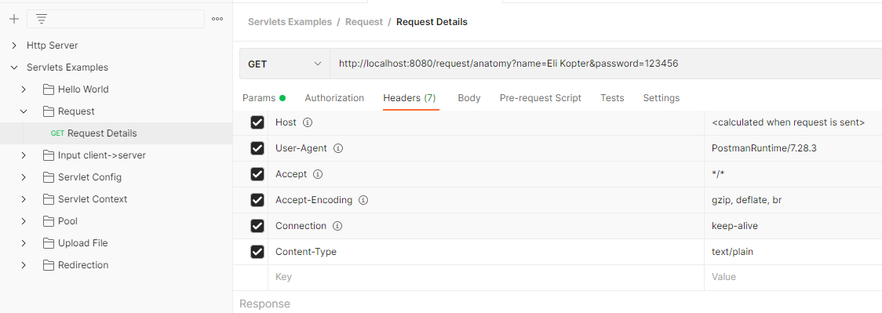
Postman – Http Client
Postman offers rich GUI through which you can define, execute, observe and manipulate http requests. Among others:
    Method
    Headers
    Query parameters
    Body
    Cookie management
    Authentication methods (not covered in this course)
    Many more...

Slide 20
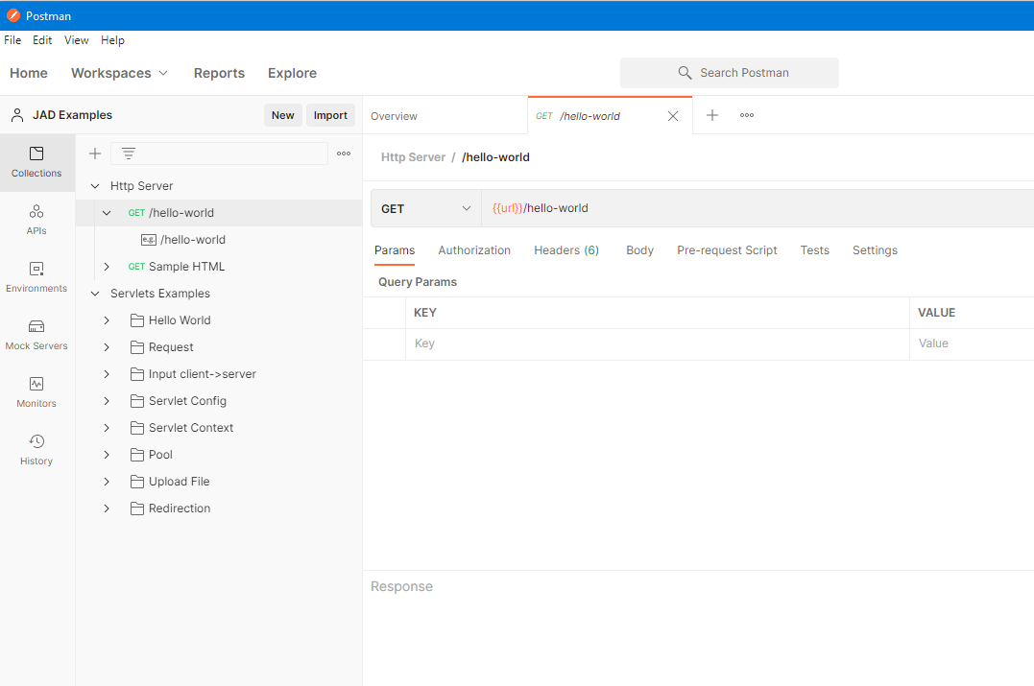
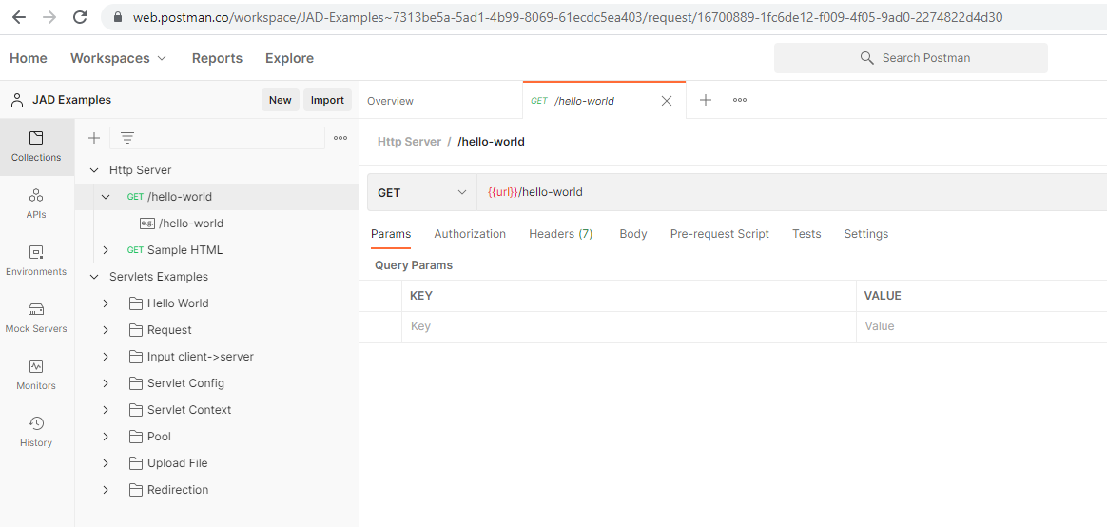
Postman – Http Client
Postman can be consumed via WEB app or Desktop app.
    Requires (free) sign up
    Both on\off line options are always in-sync
Postman offers enhance capabilities (not covered in this lecture):
    Mock servers
    Testing suites for APIs
    Authentication methods support
    Supporting various API standards
    Monitoring servers
    ...

Slide 21
Postman
POST endpoint
DEMO

Slide 22





HTTP Client Library
HTTP Client is a library that helps programmers “speak” the http language (== protocol) via code
Each technology offers vast 3rd parties http clients
OkHttp

Slide 23
HTTP Client Library
The flow with http client library will include (high level):
Create a client
  Holds the internal logic and management of the requests\reponses
Create\prepare request object\container
  Holds the resource and domain
  Holds query parameters (if needed)
  Holds headers
  Holds body (if needed)
Launch the request through the client
  A\Synch handlement
Consume the response
  Holds status code
  Holds headers
  Hodls response body

Slide 24
OKHttpClient
DEMO

